Slide 1
Constructing Objects
The Rectangle object is not a rectangular shape.
It is an object that contains a set of numbers.
The numbers describe the rectangle
Each rectangle is described by:
The x- and y-coordinates of its top-left corner
Its width
And its height.

Slide 2
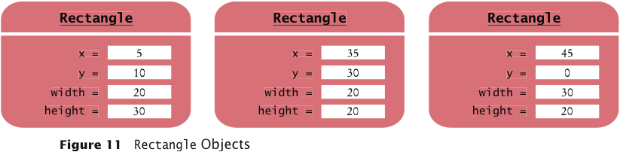
Constructing Objects
In the computer, a Rectangle object is a block of memory that holds four numbers.

Slide 3
Constructing Objects
Use the new operator, followed by a class name and arguments, to construct new objects.
new Rectangle(5, 10, 20, 30)
Detail:
The new operator makes a Rectangle object
It uses the parameters (in this case, 5, 10, 20, and 30) to initialize the data of the object
It returns the object
The process of creating a new object is called construction.
The four values 5, 10, 20, and 30 are called the construction arguments.

Slide 4
Constructing Objects
Usually the output of the new operator is stored in a variable:
Rectangle box = new Rectangle(5, 10, 20, 30);
Additional constructor:
new Rectangle()

Slide 5
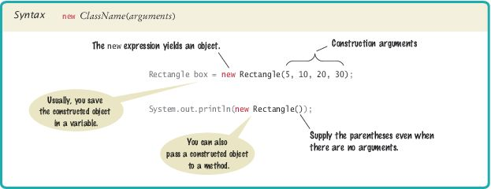
Syntax 2.3 Object Construction

Slide 6
Self Check 2.20
How do you construct a square with center (100, 100) and side length 20?
Answer:
new Rectangle(90, 90, 20, 20)

Slide 7
Self Check 2.21
Initialize the variables box and box2 with two rectangles that touch each other.
Answer:
Rectangle box = new Rectangle(5, 10, 20, 30); Rectangle box2 = new Rectangle(25, 10, 20, 30);

Slide 8
Self Check 2.22
The getWidth method returns the width of a Rectangle object. What does the following statement print? System.out.println(new Rectangle().getWidth());
Answer:
0

Slide 9
Self Check 2.23
The PrintStream class has a constructor whose argument is the name of a file. How do you construct a PrintStream object with the construction argument "output.txt"?
Answer:
new PrintStream("output.txt”);

Slide 10
Self Check 2.24
Write a statement to save the object that you constructed in Self Check 23 in a variable.
Because we will always save objects in a variable!
Answer:
PrintStream out = new PrintStream("output.txt");

